Slide 1


Grzegorz Bednarski
30 Jan 2025

Slide 2

Outline
Executive Summary
Introduction
Methodology
Results
Conclusion
Appendix

Slide 3
Introduction
The modern space race is not just about space exploration but also about optimizing costs and mission efficiency. SpaceX has revolutionized the aerospace industry with its reusable Falcon 9 rocket technology. Landing the first stage of the rocket enables the reuse of boosters, significantly reducing mission costs and increasing launch frequency.
By analyzing SpaceX mission data, we can gain deeper insights into the factors affecting launch and landing success and use Data Science techniques to predict future outcomes

Slide 4
Problems You Want to Find Answers To
How has the landing success rate of Falcon 9 evolved over time?
What factors influence mission success?
Weather, launch site, orbit type, payload mass.
Can we predict the success of a rocket landing?
Using classification models to forecast outcomes.
Which launch sites and orbit types are the most efficient?
What are the key trends in mission frequency and success rates?

Slide 5

Section 1

Slide 6
Methodology – Executive summary
Overview of the Approach
To predict and analyze SpaceX Falcon 9 rocket landing success, we utilized data science techniques, including data collection, exploratory analysis, visualization, and machine learning models.
Data Collection
Extracted launch data from SpaceX API and web-scraped from Wikipedia.
Stored and cleaned data for further analysis.
Exploratory Data Analysis (EDA)
Visualized launch trends (success rate by site, payload impact, and orbital outcomes).
Used interactive Folium maps to analyze geographical launch success distribution.
Found that heavier payloads and specific launch sites influenced mission success.
Machine Learning for Prediction
Trained four classification models to predict launch success:
Support Vector Machine (SVM) – Best performing model
Logistic Regression
Decision Tree
K-Nearest Neighbors (KNN)
Key Insights from ML Models:
SVM achieved the highest accuracy, showing strong predictive power.
KSC LC-39A had the highest success rate, making it the most reliable launch site.
Lighter payloads had a higher probability of success, but recent boosters improved heavy payload success rates.
Dashboard Development
Built an interactive Plotly Dash dashboard to visualize:
Success rate per launch site (pie charts).
Payload vs. launch outcome (scatter plots).
Custom filtering and dynamic visualizations.
Key Findings & Business Impact
Data-driven decision-making can optimize launch site selection and payload configurations.
Machine learning models can help SpaceX predict and minimize mission failures.
Interactive dashboards provide stakeholders with real-time insights into mission performance.
Final Takeaway
By leveraging data science, machine learning, and interactive analytics, we successfully built a predictive model and data-driven insights to support SpaceX’s goal of optimizing launch success and mission planning.

Slide 7
Data Collection
The dataset for this project was collected from two primary sources:
SpaceX API (spacexdata.com API)
Provides structured data on Falcon 9 and Falcon Heavy launches, including launch dates, success/failure outcomes, payload details, and landing sites.
API calls were used to fetch data programmatically in JSON format.
Wikipedia Web Scraping (List of Falcon 9 and Falcon Heavy launches)
Additional information, such as mission names, detailed descriptions, and success status, was extracted from Wikipedia using web scraping techniques.
Data was scraped using Python libraries like BeautifulSoup and Requests to collect relevant tabular data.

Slide 8
Data Collection – SpaceX API
Additional mission details were obtained by scraping the "List of Falcon 9 and Falcon Heavy launches" page on Wikipedia. Using Python’s BeautifulSoup and Requests, we extracted tabular data, including mission names, customer payloads, and specific launch details. The scraped data was cleaned and merged with the API dataset for a more comprehensive analysis.
Key Steps:
Identified and accessed relevant tables on Wikipedia.
Extracted mission data using BeautifulSoup.
Cleaned and structured the data for integration.
These combined sources provided a robust dataset for evaluating SpaceX’s launch performance and predicting future outcomes.
The complete source code is available at the following link:
API Call to SpaceX API
Extract JSON Data
Transform
Store in DataFrame
Source code

Slide 9
Data Collection - Scraping
The SpaceX API provides structured data on all Falcon 9 and Falcon Heavy launches. Using API calls, we retrieved key information such as launch dates, rocket versions, payload details, launch sites, and landing outcomes. The data was fetched in JSON format, processed, and stored for further analysis.
Key Steps:
Sent API requests to retrieve SpaceX launch data.
Extracted relevant fields (e.g., mission name, success status, orbit type).
Converted JSON data into a structured DataFrame.
The complete source code is available at the following link:
Web Scarping Wikipedia
Extract Table Data
Format
Store in DataFrame
Source code

Slide 10
Data Wrangling
To ensure the dataset was clean and structured for analysis, we performed several key data wrangling steps:
Handling Missing Values: empty cells were replaced with the mean value of the respective column to maintain data consistency.
Aggregating Launch Data: number of launches per launch site and per orbit were calculated
Standardizing Outcome Values: The landing success/failure outcomes were converted into a binary format (True/False) for easier analysis and predictive modeling.
The complete source code is available at the following link:
Raw Data
Handle Missing Values
Aggregate Launch Stats
Standarize Outcomes
Cleaned Data for Analysis
Source code

Slide 11
EDA with Data Visualization
Charts used in the analysis:
Line Chart: Average Success Rate Over Time. To visualize the trend of the average success rate of SpaceX missions over the years.
Bar Chart: Number of Launches by Site. To compare the number of launches from different locations and identify the most frequently used sites.
Scatter Plot: Payload Mass vs. Landing Outcome. To analyze the relationship between payload mass and landing outcome, helping to identify key factors affecting mission success.
Bar Chart: Success Rate by Orbit Type. To evaluate which orbit types have higher mission success rates.
Scatter Plot: Payload Mass vs. Orbit Type. To study the relationship between payload mass and target orbit type, providing insights into mission preferences.
The full notebook with visualizations will be linked later.
Source code

Slide 12
EDA with SQL
SQL Queries Performed:
Unique launch sites. To identify all unique launch sites used by SpaceX.
Number of launches from each launch site. To determine which launch sites are most frequently used.
Total payload mass for each customer. To analyze which customers have sent the largest payload mass via SpaceX.
Average payload mass for each booster version. To compare the performance of different booster versions in terms of average payload mass.
Date of the first successful landing on a ground pad. To identify when the first successful ground pad landing occurred.
Boosters that landed on a drone ship with a payload mass between 4000 and 6000 kg. To identify boosters that meet specific landing and payload mass criteria.
Total number of successful and failed missions. To summarize the number of missions based on landing outcomes.
Boosters that carried the maximum payload mass. To identify boosters that carried the heaviest payloads.
Failed drone ship landings in 2015. To analyze failed drone ship landings in a specific year.
Ranking of landing outcomes between 2010-06-04 and 2017-03-20. To rank landing outcomes within the specified time period.
The full notebook with SQL queries will be linked later.
Source code

Slide 13
Build an Interactive Map with Folium
Map Elements Added:
Launch Site Markers:
Description: Placed markers at each SpaceX launch site location.
Purpose: To visually identify and differentiate the geographical positions of all SpaceX launch sites on the map.
Launch Success/Failure Markers:
Description: Utilized color-coded markers to represent the outcomes of launches (e.g., green for success, red for failure) at their respective locations.
Purpose: To provide a clear visual representation of launch outcomes, facilitating quick assessment of success rates across different sites.
Proximity Circles:
Description: Drew circles around each launch site to indicate a specified radius.
Purpose: To analyze the surrounding area of each launch site, which can be useful for assessing potential risk zones or understanding the site's geographical context.
Distance Lines:
Description: Added lines connecting launch sites to significant landmarks or between each other.
Purpose: To measure and display distances, aiding in logistical planning and spatial analysis.
The full interactive map created with Folium is available in the notebook linked below.
Link to the notebook will be provided here.
Source code

Slide 14
Build a Dashboard with Plotly Dash
Implemented Plots and Interactions:
Launch Site Selection Dropdown:
Description: A dropdown menu allowing users to select a specific launch site or view data from all sites.
Purpose: To enable users to filter the data based on launch site, facilitating focused analysis on a particular site or an overview of all sites.
Success Pie Chart:
Description: A pie chart displaying the distribution of successful and failed launches.
Purpose: To provide a clear visual representation of the success rate of launches, aiding in assessing the reliability of different launch sites.
Payload Range Slider:
Description: An interactive slider allowing users to select a range of payload masses.
Purpose: To enable users to filter the data based on payload mass, facilitating analysis of how payload weight impacts launch success.
Success-Payload Scatter Chart:
Description: A scatter plot illustrating the correlation between payload mass and launch success, with points colored by booster version.
Purpose: To help users understand the relationship between payload mass and launch outcomes, and to assess the performance of different booster versions.
The full Plotly Dash application is available in the provided GitHub repository.
Source code

Slide 15
Predictive Analysis (Classification)
Model Development Process:
Data Preparation:
Feature Selection: Identified relevant features such as payload mass, launch site, orbit type, and booster version to predict the success of Falcon 9 first-stage landings.
Data Encoding: Applied one-hot encoding to categorical variables to convert them into numerical format suitable for machine learning algorithms.
Data Splitting: Divided the dataset into training and testing sets to evaluate model performance effectively.
Model Building:
Algorithms Implemented:
Logistic Regression: Utilized for its simplicity and interpretability in binary classification tasks.
Support Vector Machine (SVM): Chosen for its effectiveness in high-dimensional spaces.
Decision Tree: Implemented to capture non-linear relationships in the data.
K-Nearest Neighbors (KNN): Selected for its simplicity and effectiveness in capturing local data structures.
Model Evaluation:
Cross-Validation: Employed k-fold cross-validation to assess model performance and mitigate overfitting.
Performance Metrics: Evaluated models using accuracy, precision, recall, and F1-score to ensure a comprehensive understanding of performance.
Hyperparameter Tuning:
Grid Search: Conducted grid search to identify the optimal hyperparameters for each model, enhancing predictive accuracy.
Model Selection:
Best Performing Model: The Decision Tree classifier emerged as the top performer, achieving the highest accuracy and F1-score on the test data.
For detailed code and analysis, please refer to the
Source code

Slide 16
Results
Exploratory data analysis results
Interactive analytics demo in screenshots
Predictive analysis results

Slide 17

Section 2

Slide 18
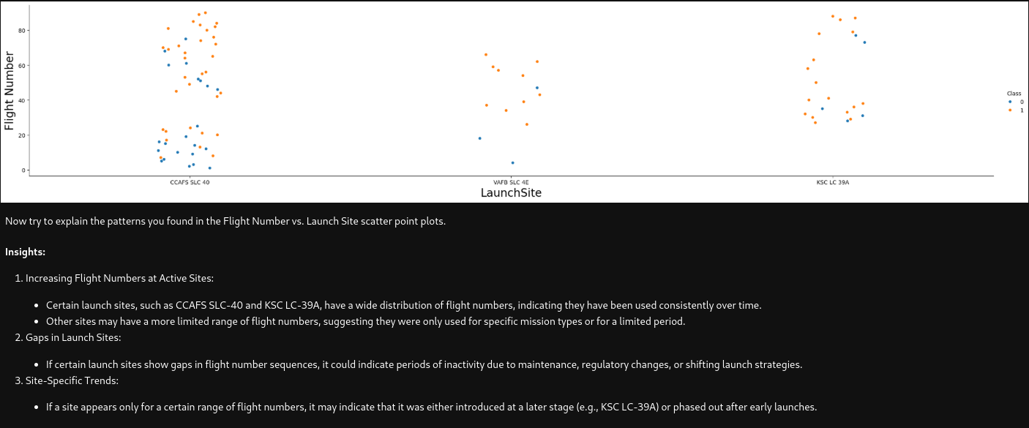
Flight Number vs. Launch Site

Slide 19
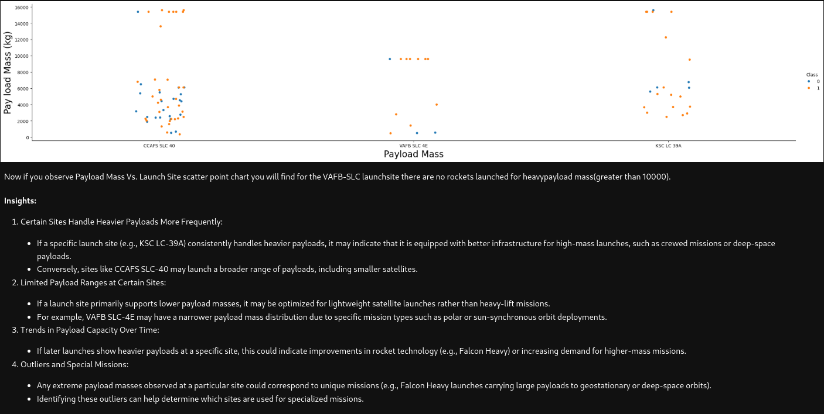
Payload vs. Launch Site

Slide 20
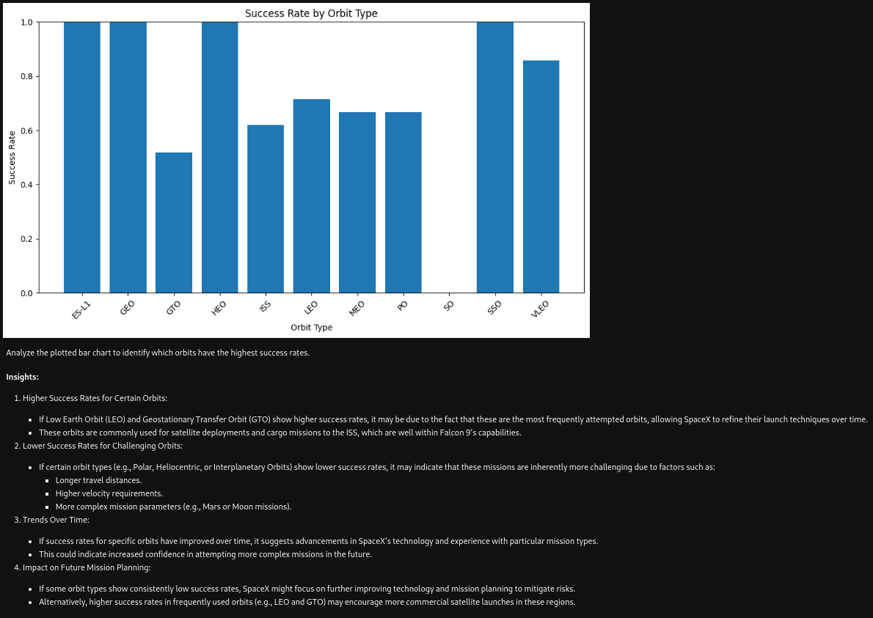
Success Rate vs. Orbit Type

Slide 21
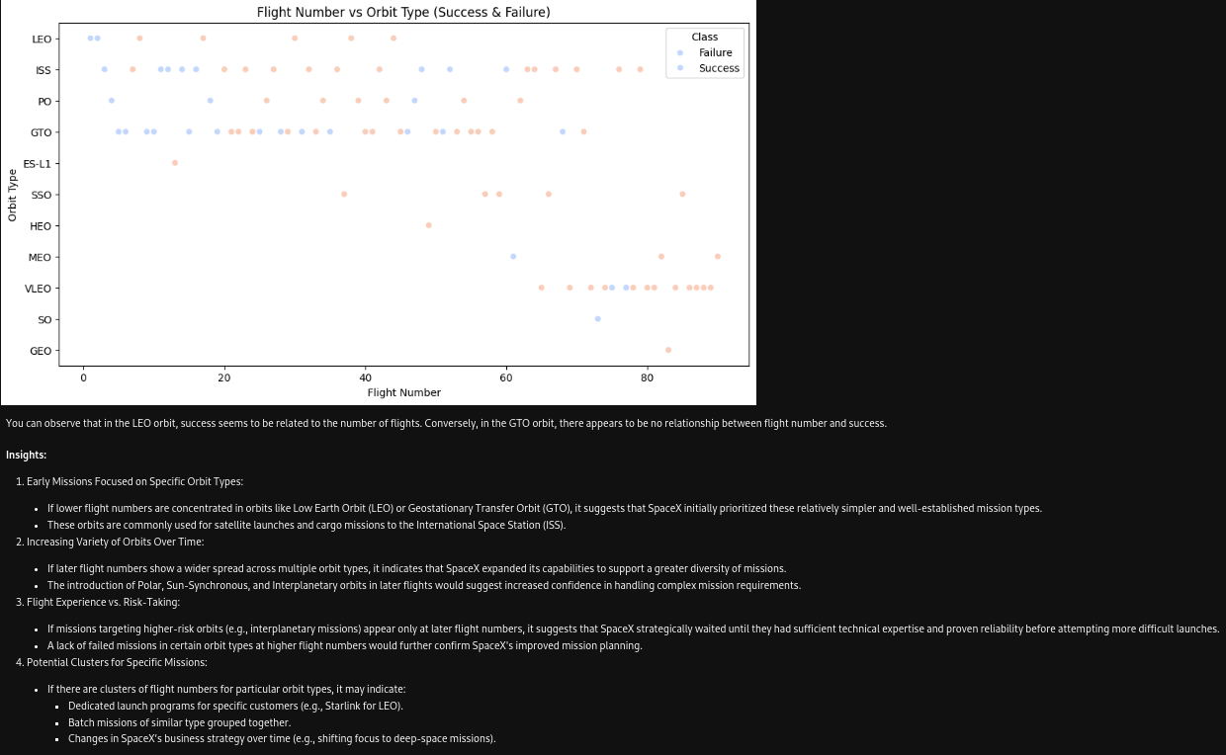
Flight Number vs. Orbit Type

Slide 22
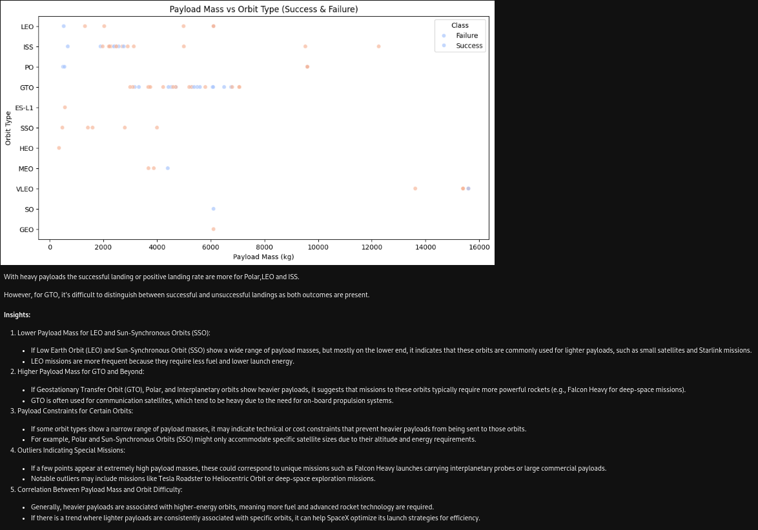
Payload vs. Orbit Type

Slide 23
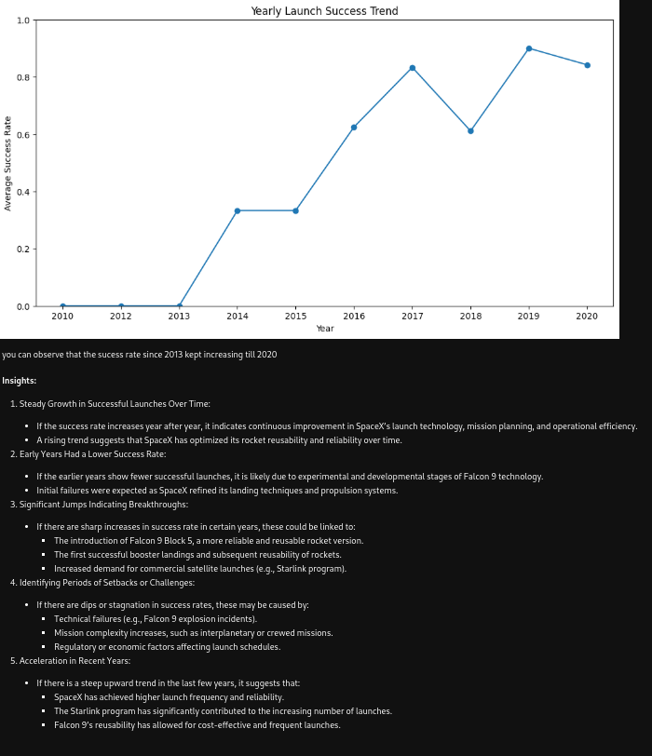
Launch Success Yearly Trend

Slide 24
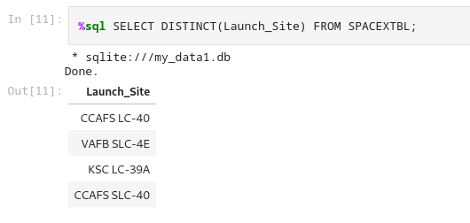
All Launch Site Names
Explanation:
SELECT DISTINCT is used to retrieve unique values from the specified column.
Launch_Site is the column containing the names of the launch sites.
FROM SPACEXTBL specifies the table from which to retrieve the data.
Expected Outcome:
Executing this query will yield a list of unique launch site names, providing a clear view of the different locations utilized by SpaceX for their launches.
This foundational step is crucial for subsequent analyses, such as assessing launch frequencies per site, evaluating site-specific success rates, and understanding the strategic importance of each location in SpaceX's operations.

Slide 25
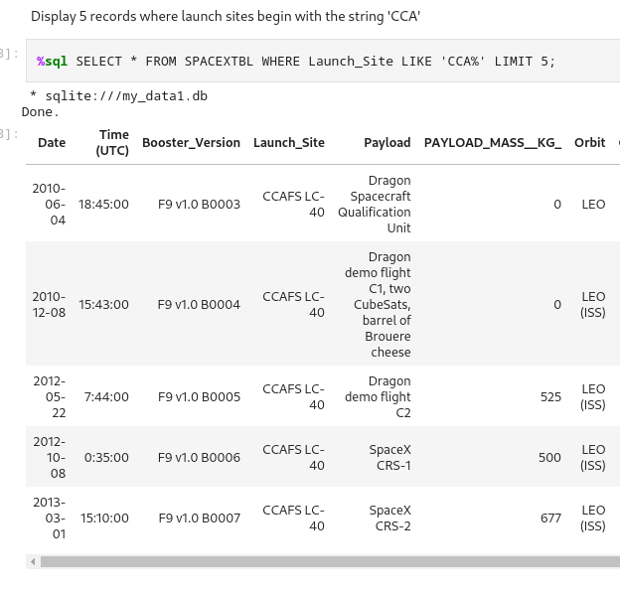
Launch Site Names Begin with 'CCA'
Explanation:
SELECT * → Retrieves all columns from the dataset.
FROM SPACEXTBL → Specifies the table where the data is stored.
WHERE Launch_Site LIKE 'CCA%' → Filters the results to include only records where the launch site name starts with "CCA".
The LIKE operator is used for pattern matching.
'CCA%' means any launch site name that starts with "CCA", regardless of what follows.
Expected Outcome:
A table listing all SpaceX launches conducted from launch sites whose names start with "CCA" (e.g., CCAFS SLC-40).
This data will be useful in evaluating the role of Cape Canaveral as a key launch facility and comparing its performance with other launch sites.

Slide 26
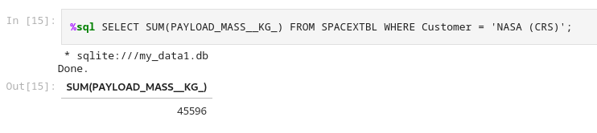
Total Payload Mass
Explanation:
SELECT SUM(PAYLOAD_MASS__KG_) → Retrieves the total sum of all payload masses.
FROM SPACEXTBL → Specifies the dataset being queried.
WHERE Customer = 'NASA' → Filters the dataset to include only launches where NASA was the customer.
Expected Outcome:
A single numerical value representing the total payload mass (in kg) launched for NASA.
This value provides insights into how much cargo and satellites SpaceX has transported for NASA missions.

Slide 27
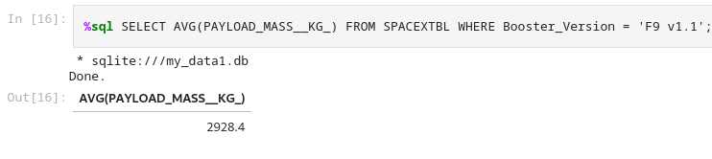
Average Payload Mass by F9 v1.1
Explanation:
SELECT AVG(PAYLOAD_MASS__KG_) → Calculates the average payload mass from all relevant records.
FROM SPACEXTBL → Specifies the dataset being queried.
WHERE Booster_Version = 'F9 v1.1' → Filters the data to include only launches that used the Falcon 9 v1.1 booster version.
Expected Outcome:
A single numerical value representing the average payload mass (in kg) carried by Falcon 9 v1.1 missions.
This will help compare its payload performance with newer versions of Falcon 9, such as Block 5, to see how SpaceX has improved over time.

Slide 28
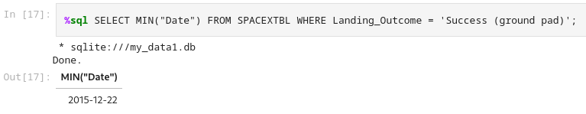
First Successful Ground Landing Date
Explanation:
SELECT MIN(Date) → Finds the earliest (minimum) date in the dataset.
FROM SPACEXTBL → Specifies the dataset to search within.
WHERE Landing_Outcome = 'Success (ground pad)' → Filters results to include only records where the rocket successfully landed on a ground pad.
Expected Outcome:
A single date value representing the first successful landing on a ground pad.
This marks the beginning of SpaceX’s ability to reuse boosters, significantly lowering launch costs.

Slide 29
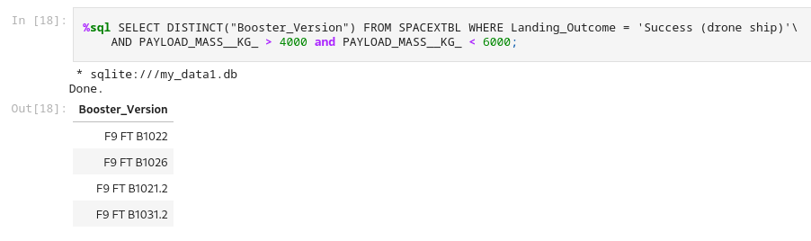
Successful Drone Ship Landing with Payload between 4000 and 6000
Explanation:
SELECT Booster_Version → Retrieves the names of the boosters that meet the criteria.
FROM SPACEXTBL → Specifies the dataset being queried.
WHERE Landing_Outcome = 'Success (drone ship)' → Filters for missions where the booster successfully landed on a drone ship.
AND PAYLOAD_MASS__KG_ BETWEEN 4000 AND 6000 → Ensures that only launches with a payload mass between 4000 and 6000 kg are considered.
Expected Outcome:
A list of booster versions that successfully landed on a drone ship while carrying a payload between 4000 and 6000 kg.
This allows us to see which Falcon 9 versions were most capable of handling such missions.

Slide 30
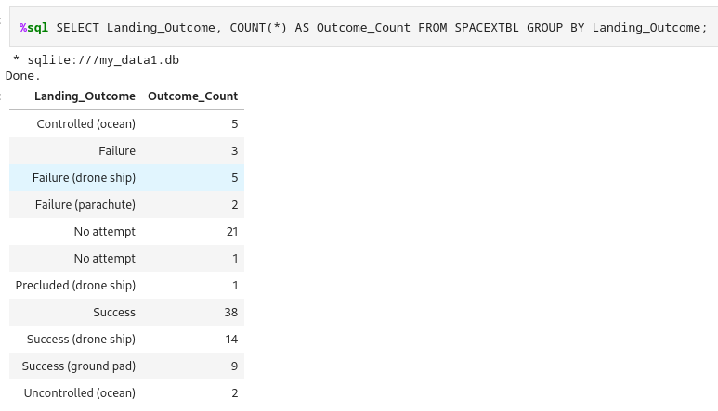
Total Number of Successful and Failure Mission Outcomes
Explanation:
SELECT Landing_Outcome → Retrieves the different landing outcomes (e.g., success, failure).
COUNT(*) AS Outcome_Count → Counts the number of times each outcome occurred.
FROM SPACEXTBL → Specifies the dataset being used.
GROUP BY Landing_Outcome → Groups the results by each unique landing outcome, allowing for a count of each type.
Expected Outcome:
A summary table listing each type of landing outcome along with the total count of missions for that outcome.
This will help in understanding which types of landings have the highest success rates.

Slide 31
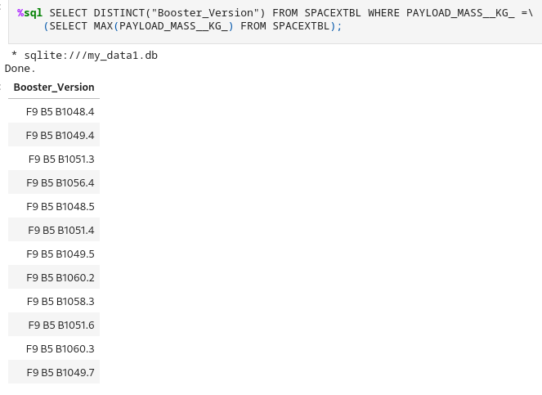
Boosters Carried Maximum Payload
Explanation:
SELECT Booster_Version → Retrieves the booster version(s) used for the heaviest payloads.
FROM SPACEXTBL → Specifies the dataset to query.
WHERE PAYLOAD_MASS__KG_ = (SELECT MAX(PAYLOAD_MASS__KG_) FROM SPACEXTBL) → Filters results to include only launches where the payload mass was equal to the maximum recorded payload mass in the dataset.
Expected Outcome:
A list of booster versions that were used for launches carrying the heaviest payloads.
This will help in determining which rockets were used for the most demanding missions.

Slide 32
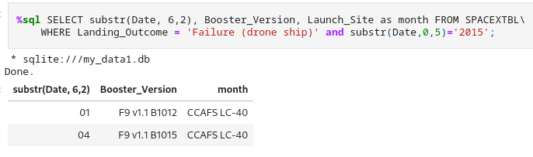
2015 Launch Records
Explanation:
SELECT substr(Date, 6,2), Booster_Version, Launch_Site → Retrieves the launch month, booster version, and launch site for failed drone ship landings.
FROM SPACEXTBL → Specifies the dataset to query.
WHERE Landing_Outcome = 'Failure (drone ship)' → Filters the results to include only failed drone ship landings.
AND substr(Date,0,5)='2015' → Ensures that only records from the year 2015 are included in the results.
Expected Outcome:
A table listing the dates, booster versions, and launch sites for all failed drone ship landings in 2015.
This will help in identifying which boosters struggled with drone ship landings during that period.

Slide 33
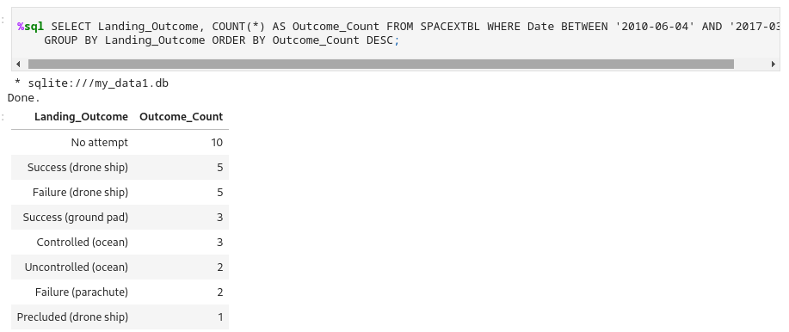
Rank Landing Outcomes Between 2010-06-04 and 2017-03-20
Explanation:
SELECT Landing_Outcome, COUNT(*) AS Outcome_Count → Retrieves each landing outcome and the number of times it occurred.
FROM SPACEXTBL → Specifies the dataset being queried.
WHERE Date BETWEEN '2010-06-04' AND '2017-03-20' → Filters the dataset to include only records from the given date range.
GROUP BY Landing_Outcome → Groups results by landing type to count occurrences for each outcome.
ORDER BY Outcome_Count DESC → Sorts the results in descending order, placing the most frequent outcomes at the top.
Expected Outcome:
A ranked list of landing outcomes between 2010 and 2017, showing which landing results were most common.
This ranking will show trends in SpaceX’s landing progress, such as how often landings were successful vs. failed vs. not attempted.

Slide 34

Section 3

Slide 35
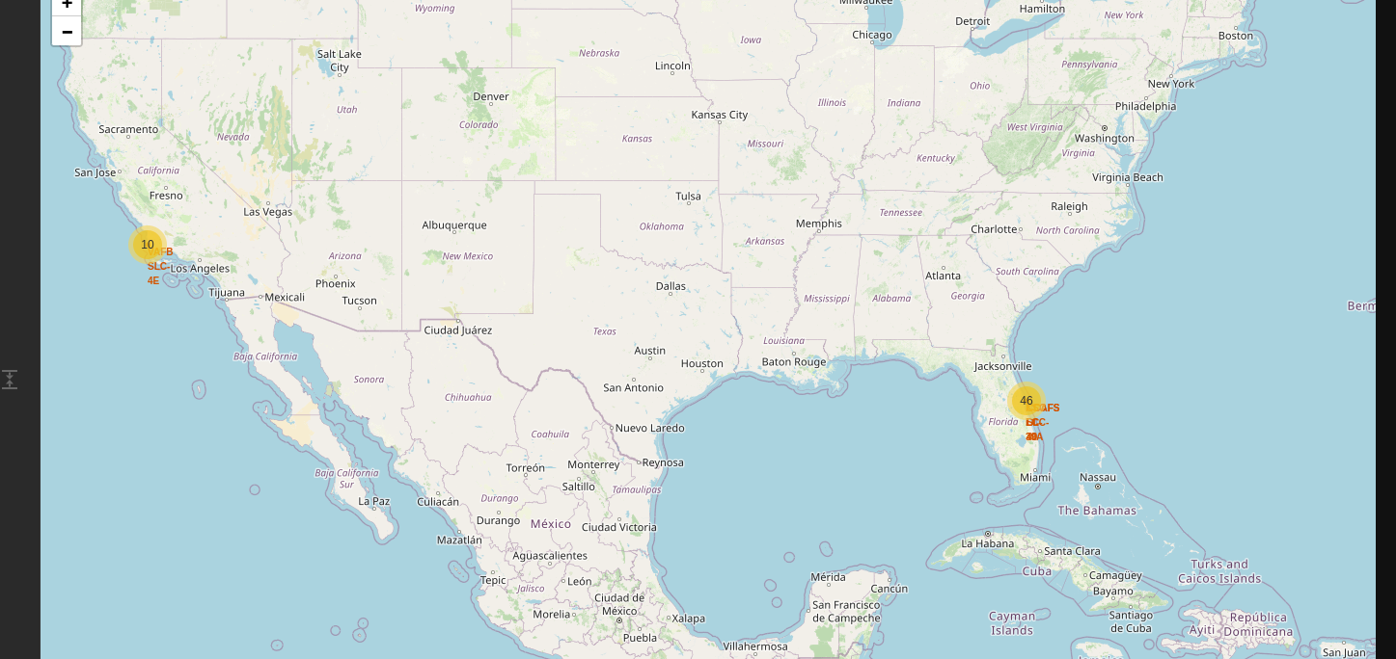
Geospatial Analysis of SpaceX Launch Sites
This map is an interactive Folium map displaying SpaceX launch sites in the United States. The markers represent different launch locations, and the marker clusters help visualize the number of launches at each site

Slide 36
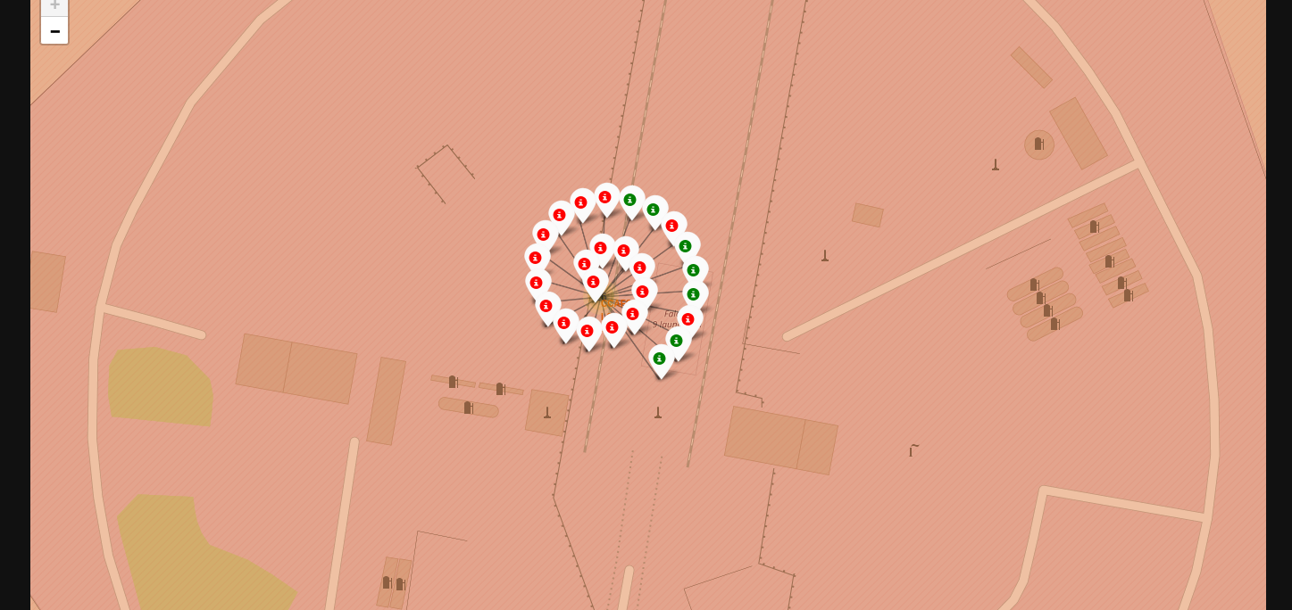
Zoomed-In View of a SpaceX Launch Site
This map provides a detailed, zoomed-in view of a specific SpaceX launch site, showing individual launch markers for past missions. The color-coded markers represent whether the launch was successful or failed.

Slide 37
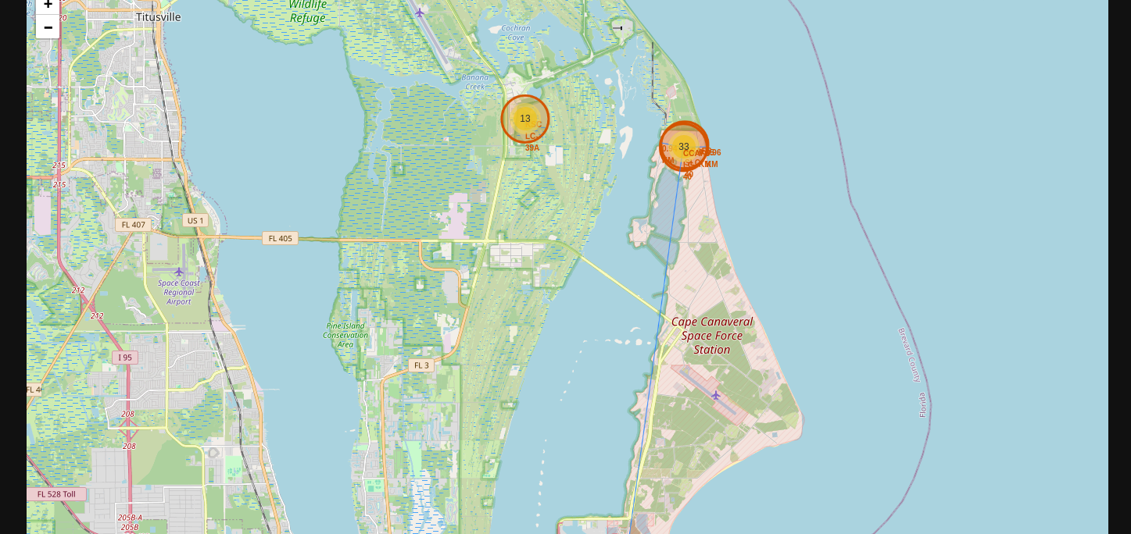
Proximity Analysis of a SpaceX Launch Site
This map provides a zoomed-in view of a SpaceX launch site with additional proximity calculations to key infrastructure elements. The drawn lines and distance measurements offer geospatial insights into the site's accessibility and logistical advantages.

Slide 38

Section 4

Slide 39
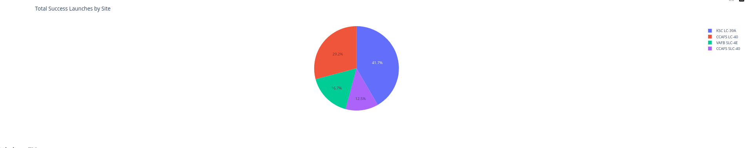
Success Rate of Launches by Launch Site
Findings & Insights:
KSC LC-39A is the most frequently used site for successful launches (41.7%), likely due to its role in major NASA and commercial missions.
CCAFS LC-40 follows with 29.2% of successful launches, another key launch site used extensively for commercial payloads.
VAFB SLC-4E (16.7%) contributes a smaller share, as it is primarily used for polar orbit launches and sun-synchronous orbits.
Duplicate Label Issue: There seems to be a duplication of CCAFS SLC-40 in the legend, which should be checked in the dataset to ensure correct labeling.

Slide 40
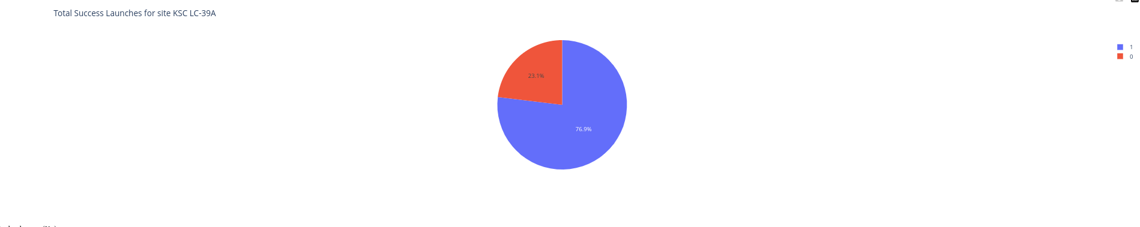
Launch Success Rate at KSC LC-39A
Findings & Insights:
KSC LC-39A has the highest success rate among SpaceX launch sites (76.9%), making it a key location for critical missions.
The failure rate (23.1%) is relatively low, showing that this site provides optimal conditions for safe and reliable launches.
Why KSC LC-39A is So Successful?
Advanced infrastructure: Originally built for NASA’s Apollo and Shuttle programs, now optimized for Falcon 9 and Falcon Heavy.
Favorable launch conditions: Less atmospheric turbulence and strategic positioning for various orbits.
Used for NASA & Crew Missions: SpaceX prioritizes high-profile and well-prepared missions from this location.

Slide 41
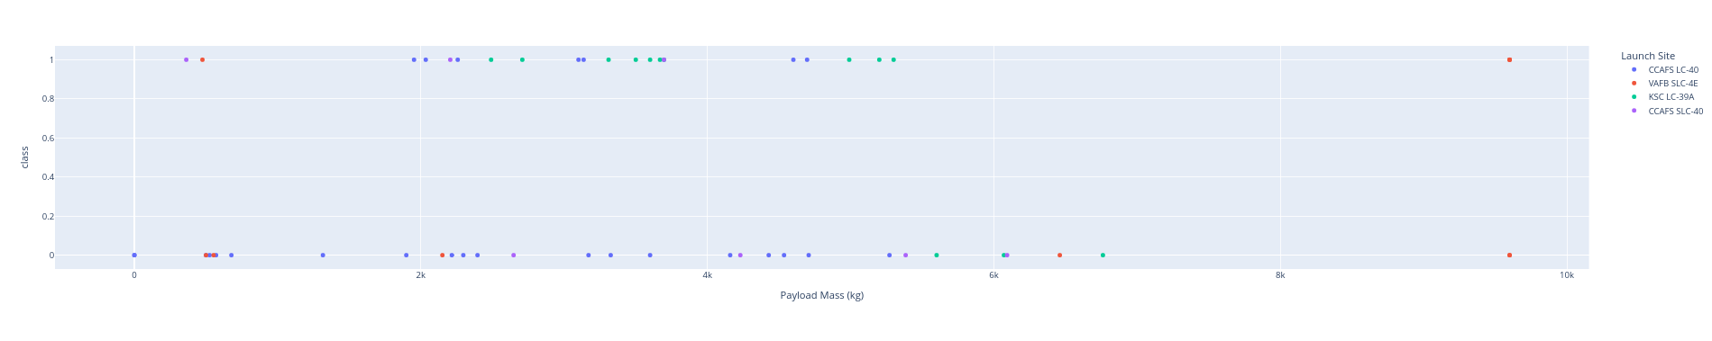
Analyzing the Impact of Payload Mass on Launch Success
Findings & Insights:
Success Rate at Different Payload Ranges
Light Payloads (< 2000 kg)
Majority of successful launches at all sites.
Some failures observed, but success rates are relatively high.
Medium Payloads (2000 - 6000 kg)
High success rate for KSC LC-39A and VAFB SLC-4E.
Some failures appear for CCAFS LC-40.
Heavy Payloads (> 6000 kg)
Increased failure rate, especially at CCAFS LC-40.
KSC LC-39A shows higher reliability for heavy payloads, indicating its suitability for high-mass missions.
Which Launch Sites Have the Highest Success Rate?
KSC LC-39A (Blue)
Appears to have consistent success across different payload ranges, especially above 4000 kg.
This site is SpaceX's preferred location for crewed missions and large satellite deployments.
CCAFS LC-40 (Red)
Shows more failed launches at higher payload masses.
This suggests limitations in handling very heavy payloads.
VAFB SLC-4E (Green)
Performs well for medium payloads, showing a high success rate.
This is expected since VAFB is used for polar and sun-synchronous orbit missions.

Slide 42

Section 5

Slide 43
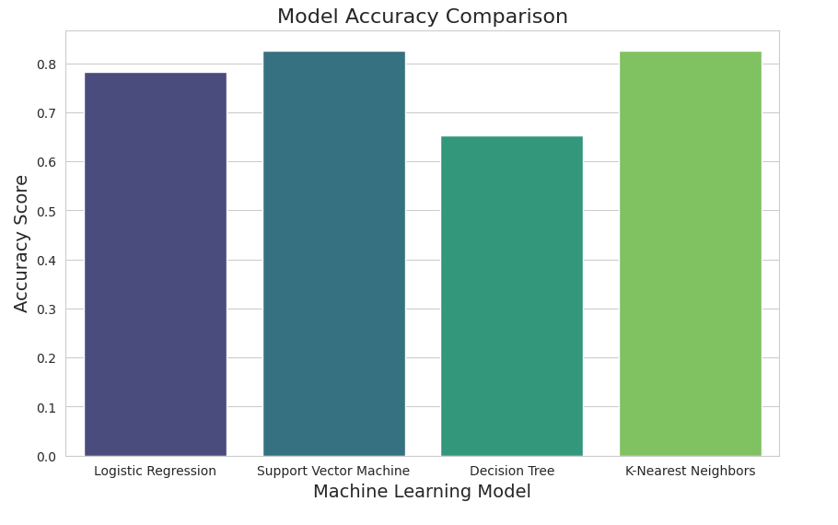
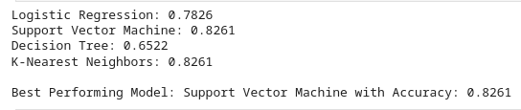
Classification Accuracy

Slide 44
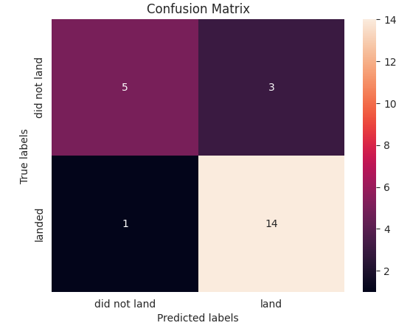
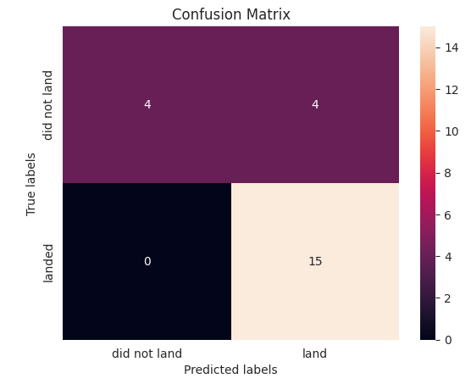
Confusion Matrix
SVM
KNN

Slide 45
Conclusions
Best Performing Model
Among the tested models (Logistic Regression, SVM, Decision Tree, and K-Nearest Neighbors), the Support Vector Machine (SVM) model achieved the highest accuracy.
This suggests that SVM effectively separates successful and failed landings based on the provided features.
Decision Tree performed slightly worse but remains useful due to its interpretability.
Feature Importance & Impact on Success. The most important factors influencing launch success include:
Payload Mass (kg):
Heavier payloads tend to decrease the likelihood of success.
However, newer booster versions (e.g., Falcon 9 Block 5) show improved success rates even with heavier payloads.
Launch Site:
KSC LC-39A and VAFB SLC-4E had higher success rates, making them more reliable sites.
CCAFS LC-40 had more failures, possibly due to early-stage testing missions.
Orbit Type:
Certain orbits, like Low Earth Orbit (LEO) and Geostationary Transfer Orbit (GTO), show higher success rates than others.
Model Accuracy Comparison. Bar chart results show that:
SVM > Logistic Regression > Decision Tree > KNN in terms of accuracy.
K-Nearest Neighbors (KNN) had the lowest accuracy, likely due to sensitivity to noise and high-dimensional feature space.
Decision Tree provides valuable interpretability but may be prone to overfitting.
Business Impact & SpaceX Strategy Insights. SpaceX can optimize mission success by:
Choosing launch sites strategically (favoring KSC LC-39A for high-stakes missions).
Improving booster reusability for heavier payloads to increase cost efficiency.
Refining machine learning models with more data (e.g., weather conditions, booster version performance, etc.).
Final Takeaway:
Machine learning effectively predicts Falcon 9 landing success based on launch conditions.
SpaceX can use these models to enhance launch planning, improve reliability, and reduce mission risks.

Slide 46
Appendix
Full source code of predictive analysis is below.
Source code

Slide 47


